Slide 1

UROP Project ID: UROP-2026-D874A2
A Hybrid Framework of Graph Algorithms and AI for Relational Modelling of Healthcare Data
Dr. Sheeja G,
Department of Mathematics,
Yash Sharma (RA2411003010957)
Yatharth Garg (RA2411003010744)

Slide 2
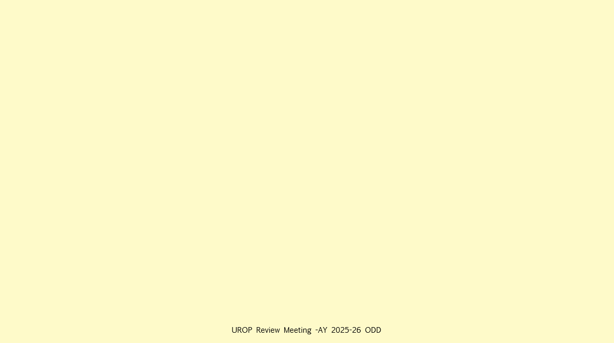
Problem Statement & Motivation
Healthcare data is inherently relational, involving complex interactions amongst patients, diseases, medications, clinicians, and clinical events. Traditional machine learning models treat patient records as independent samples and fail to capture these relationships. This project proposes a graph-based artificial intelligence framework that models healthcare data as a heterogeneous graph, applies classical graph algorithms and graph neural networks, and integrates machine learning techniques to improve disease risk and complication prediction whilst maintaining interpretability. Healthcare data is inherently relational, involving complex interactions among patients, diseases,
medications, clinicians, and clinical events.
Conventional machine learning approaches treat patient
records as independent samples, thereby ignoring structural dependencies and relational context. This
research proposes a graph-based artificial intelligence framework that models healthcare data as a
heterogeneous graph, applies classical graph algorithms to extract structural properties, and leverages
graph embeddings and graph neural networks to learn relational patterns. The objective is to improve
disease risk and complication prediction while providing interpretable structural insights into healthcare
networks.

Slide 3
Literature Review Summary
Healthcare data contains strong dependencies amongst patients, diseases, treatments, and outcomes.
Knowledge graphs provide an effective way to represent heterogeneous medical entities and relationships.
Hybrid AI systems combining symbolic reasoning and machine learning improve interpretability and trust.
Graph neural networks outperform traditional ML models in disease prediction tasks.
Explainable AI integrated with graph learning helps clinicians understand predictions.
Data modelling choices and graph structure significantly influence predictive performance.
There is limited work comparing classical ML, PCA-based learning, and GNNs within one unified framework.

Slide 4
Methodology Adopted / To Be Followed
01
02
03
Data Acquisition
Data Preprocessing
Graph Construction
Collect structured healthcare dataset (patients, diseases, medications, lab results, visits).
Handle missing values
Normalise numerical features
Encode categorical attributes
Represent patients, doctors, diseases, medications, lab tests as nodes
Define relationships as edges
04
05
06
Structural Analysis using Graph Algorithms
Feature Engineering
Learning & Prediction
Generate graph-based structural features
Generate node embeddings (Node2Vec / DeepWalk)
Train traditional ML models
Train Graph Neural Networks
BFS / DFS for neighbourhood exploration
Dijkstra for shortest path
Centrality and clustering measures
07
Evaluation & Comparison
Compare accuracy of ML, embedding-based ML, and GNN models

Slide 5
Algorithms in Project Phases
Literature Phase (Study Only)
Experimentation Phase
BFS, DFS
Dijkstra
PageRank
Node2Vec
Graph Convolutional Network (GCN)
BFS / DFS
Dijkstra / Shortest Path
Degree Centrality
Clustering Coefficient

Slide 6
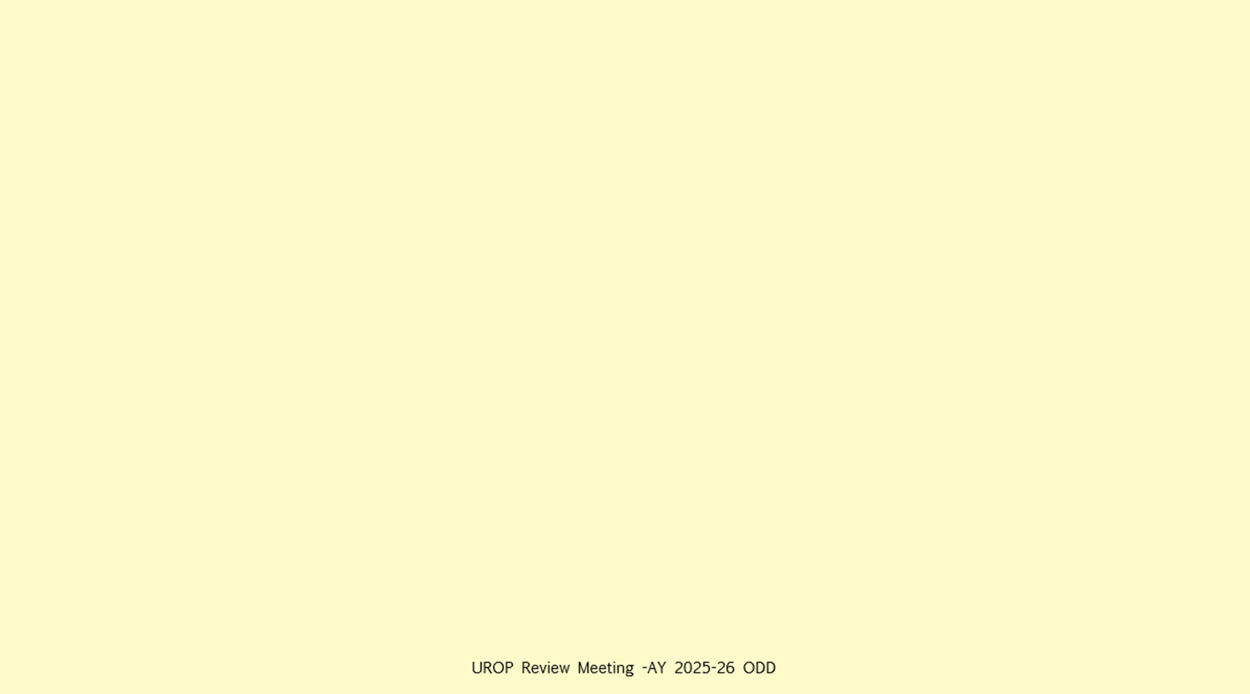
Learning Models
Node Embeddings
Traditional ML
Graph Neural Networks
Node2Vec
DeepWalk
Logistic Regression
Random Forest
XGBoost
Graph Convolutional Network (GCN)
Graph Attention Network (GAT)

Slide 7
Work Done So Far
Literature survey completed Comprehensive review of graph-based healthcare modeling, hybrid AI systems, and graph neural networks.
Problem statement finalized Clearly defined research gap focusing on relational modeling of healthcare data using graph algorithms and AI.
Project pipeline designed End-to-end workflow established, from data preprocessing and graph construction to learning and evaluation.
Algorithm stack selected Identification of classical graph algorithms, embedding techniques, traditional ML models, and GNN architectures.
Dataset identification in progress Evaluation of suitable healthcare datasets for graph-based representation and experimentation.

Slide 8
Results & Discussion
Literature-Driven Insights Surveyed studies consistently indicate that graph-based models outperform traditional tabular approaches for relational healthcare data, especially in disease risk prediction tasks.
Pipeline Feasibility Assessment The designed end-to-end pipeline is theoretically sound and aligns with best practices reported in prior research, ensuring smooth transition from data preprocessing to learning and evaluation.
Algorithm Suitability Analysis Selected graph algorithms and learning models are well-matched to the problem scope, balancing interpretability (classical graph measures) and predictive power (GNNs).
Expected Performance Trends Based on existing benchmarks, embedding-based ML models and Graph Neural Networks are expected to yield higher accuracy than baseline ML models.
Current Limitations Quantitative results are pending due to ongoing dataset identification and preprocessing; experimental validation will follow in subsequent phases.
Research Readiness The groundwork established through literature analysis and design decisions positions the project for effective experimentation and meaningful comparative analysis.

Slide 9
Work To Be Done
Finalize Dataset Selection & Acquisition Identify and procure an appropriate healthcare dataset suitable for heterogeneous graph construction.
Data Preprocessing & Feature Engineering Clean, normalize, and encode patient attributes; handle missing values and inconsistencies.
Graph Construction & Validation Model healthcare entities and relationships as a graph; validate structural correctness and connectivity.
Implementation of Graph Algorithms Apply BFS, DFS, shortest path, centrality, and clustering algorithms for structural analysis.
Embedding & Representation Learning Generate node embeddings using Node2Vec / DeepWalk for downstream learning tasks.
Model Training & Evaluation Train baseline ML models and Graph Neural Networks; compare performance across approaches.
Result Analysis & Discussion Analyze quantitative results, interpret model behavior, and relate findings to literature.
Documentation & Reporting Compile results into a structured report and prepare material for final presentation.

Slide 10
Contribution of each student team member
Contribution of Yash Sharma
Contribution of Yatharth Garg
Heterogenous Graph
Data Acquiring
Applying Graph Algorithms (BFS/DFS and Dijkstra only)
Use Algorithms to do clinical research (ML - LR, PCA with kNN, GCN)
Prediction Results - Unclear dependent on dataset.
Comparative Analysis (Which algorithm is the best at giving most accurate results.
Discussion and Limitations
Research Paper.

Slide 11
UROP Progress( Highlight your status of completion)
Work Done So Far
Phase1
10%
Literature Review
Problem identification
Objectives formulation
Phase 2 30%
Modelling
Simulation
Experiment
Phase 3 50%-70%
Analysis
Paper drafting
Phase 4 -80%
Paper Submitted to Journal
Under Review
Literature gap
Literature survey completed
Problem statement finalised
Pipeline designed
Algorithm stack selected
Dataset identification in progress

Slide 12
References
[1] Y. Chudasama, H. Huang, D. Purohit, and M.-E. Vidal, “Toward Interpretable Hybrid AI Integrating Knowledge Graphs and Symbolic Reasoning in Medicine,” IEEE Access, vol. 13, 2025, doi 10.1109ACCESS.2025.3529133.
[2] M.-E. Vidal, Y. Chudasama, H. Huang, D. Purohit, and M. Torrente, “Integrating Knowledge Graphs with Symbolic AI: The Path to Interpretable Hybrid AI Systems in Medicine,” Web Semantics: Science, Services and Agents on the World Wide Web, vol. 84, Art. no. 100856, 2025, doi: 10.1016/j.websem.2024.100856.
[3] E. Javid and W. Shah, “Hybrid AI Models for Large-Scale Information Extraction and Knowledge Map Construction,” Jan. 2025.
[4] M. Aamir, Y. K. Yu, N. Choudhry, and U. A. Bhatti, “Enhancing chronic disease management: hybrid graph networks and explainable AI for intelligent diagnosis,” Sci. Rep., vol. 15, 2026, doi: 10.1038/s41598-025-34065-5.
[5] S. Safaei, “Evaluating hybrid AI for prediction over lung cancer knowledge graphs,” Master’s thesis, Gottfried Wilhelm Leibniz Universität Hannover, Hanover, Germany, 2024.
[6] H. Lu and S. Uddin, “Disease Prediction Using Graph Machine Learning Based on Electronic Health Data: A Review of Approaches and Trends,” Healthcare, vol. 11, Art. no. 1031, 2023, doi: 10.3390/healthcare11071031.

